Slide 1
Amplify Media Player
Coach : Sanchit Gharat
Soujanya Kalal Vikas D
Vedavathi Shriyan Jalaja D G
Girish R Yashas Pathange
K Sumanth Prathiksha Shetty
Bijoy Das

Slide 2
Media Player:
This is a media player that can play video files and audio files with video visualizer, and includes both keyboard and GUI features for controlling playback. The player is written in C++ using the GStreamer framework and the GTK+ toolkit.

Slide 3
Features Of Media Player:
Play/Pause
Resume
Stop
Play Next/Previous Media
Seek Forward and Backward Media
Shuffle playlist
Repeat Media
Metadata Information
Open File/Directory
Playlist View
Favorite
Mute
Sleep Time and Dark Mode
Quit
Help

Slide 4
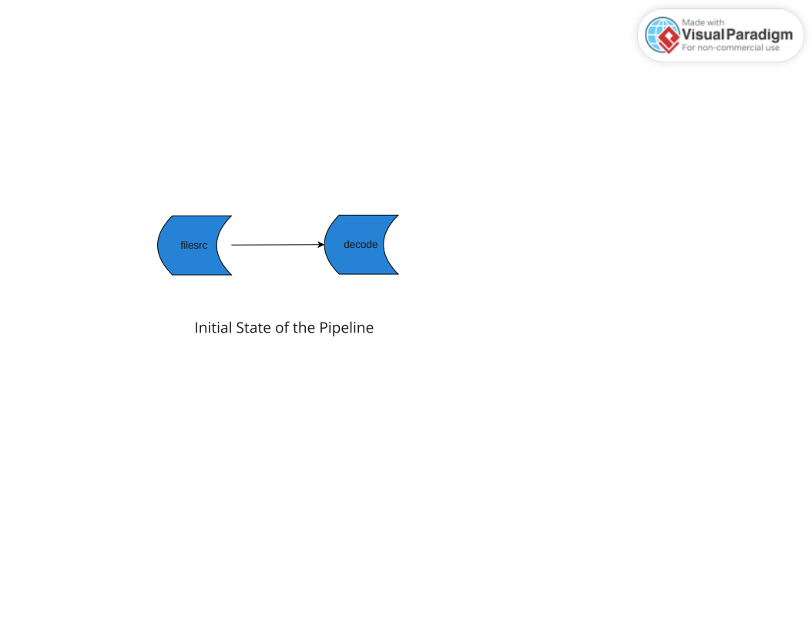
Initial State of the Pipeline:

Slide 5
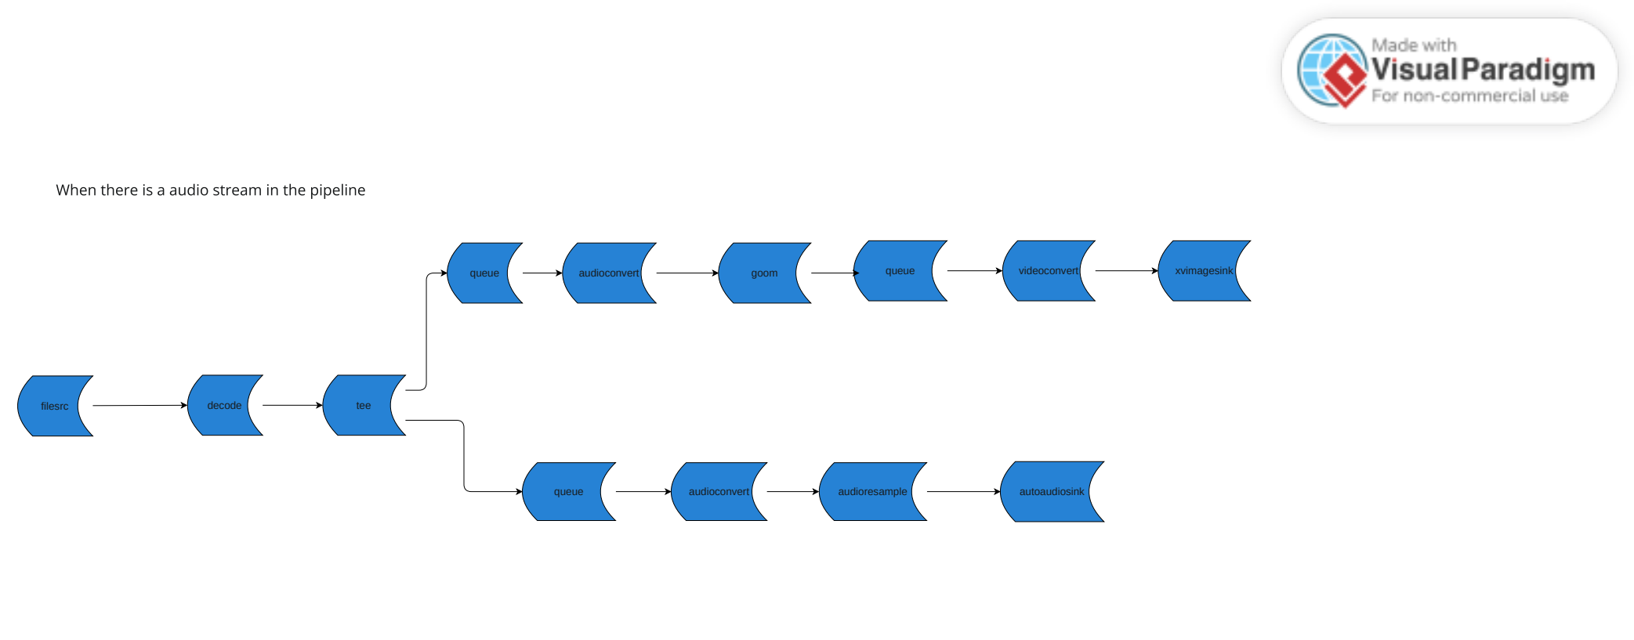
Audio Stream of the Pipeline

Slide 6
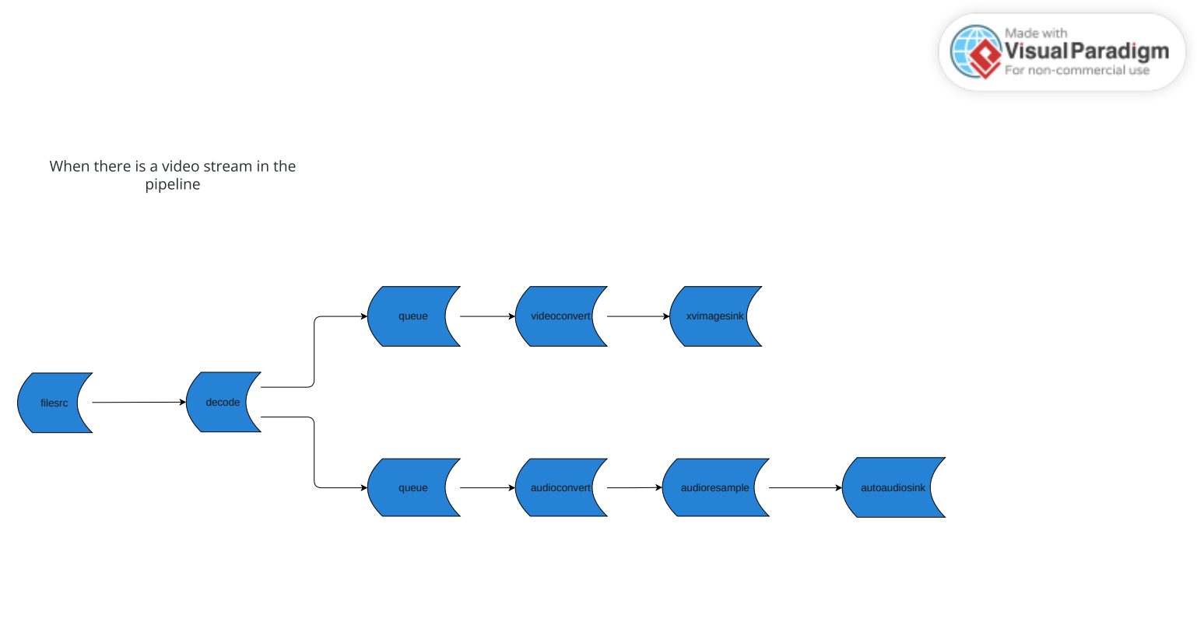
Video Stream of the Pipeline:

Slide 7
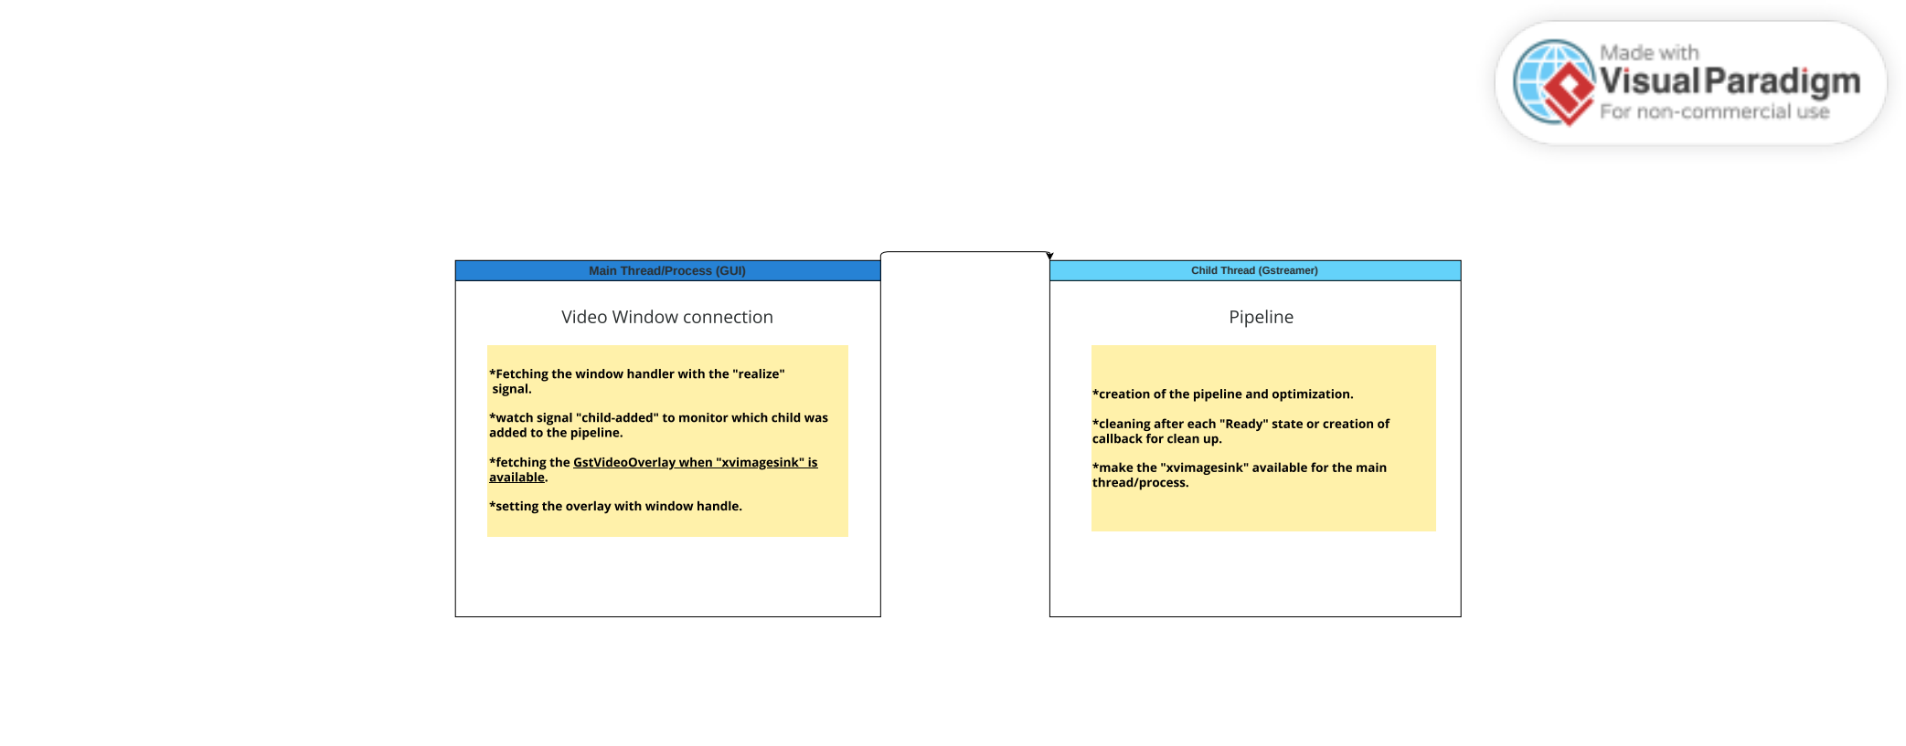
GUI Pipeline Connection:

Slide 8
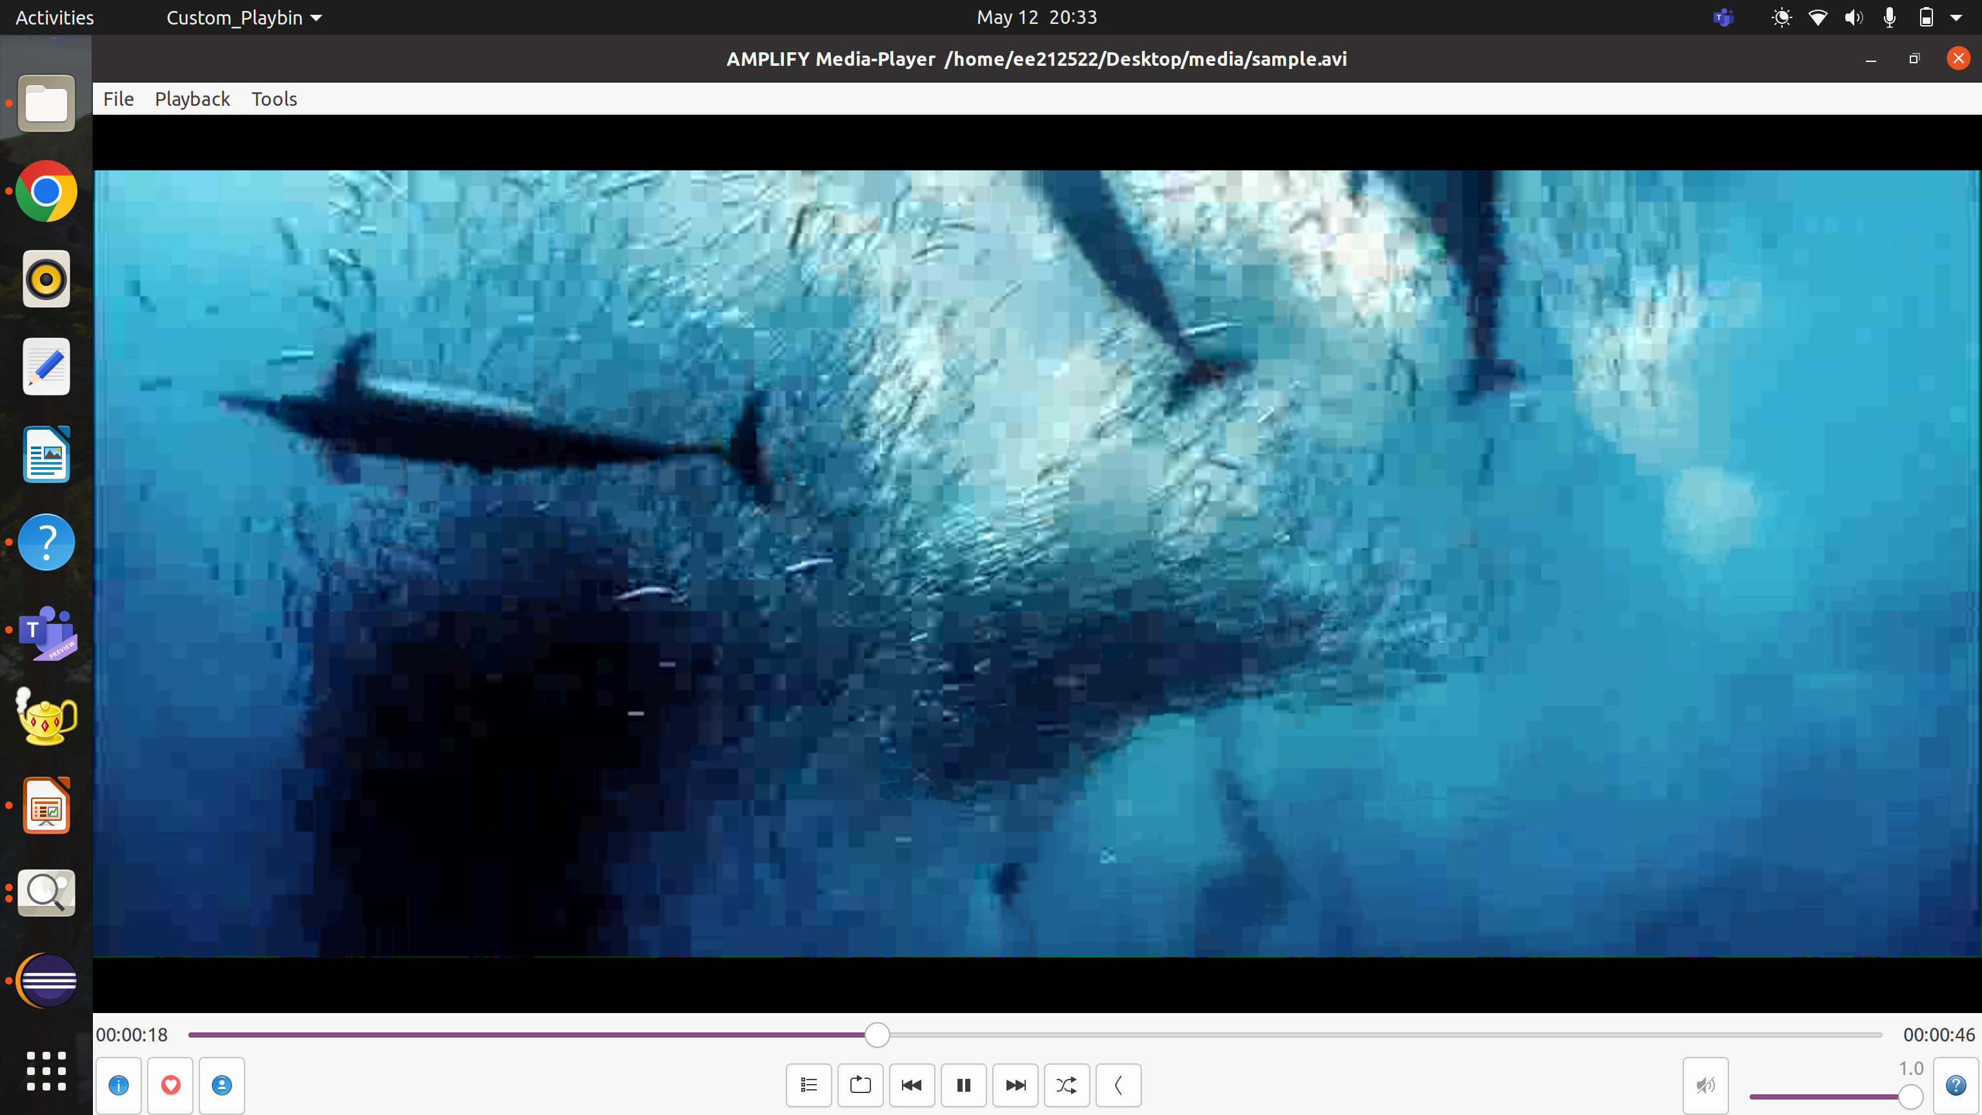
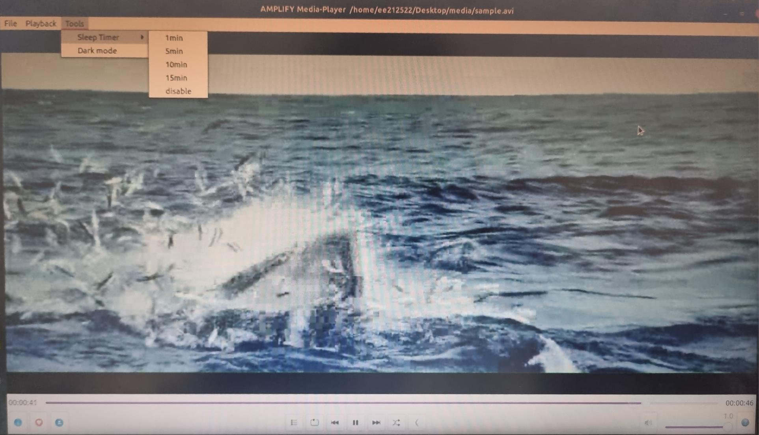
Media Player View:

Slide 9
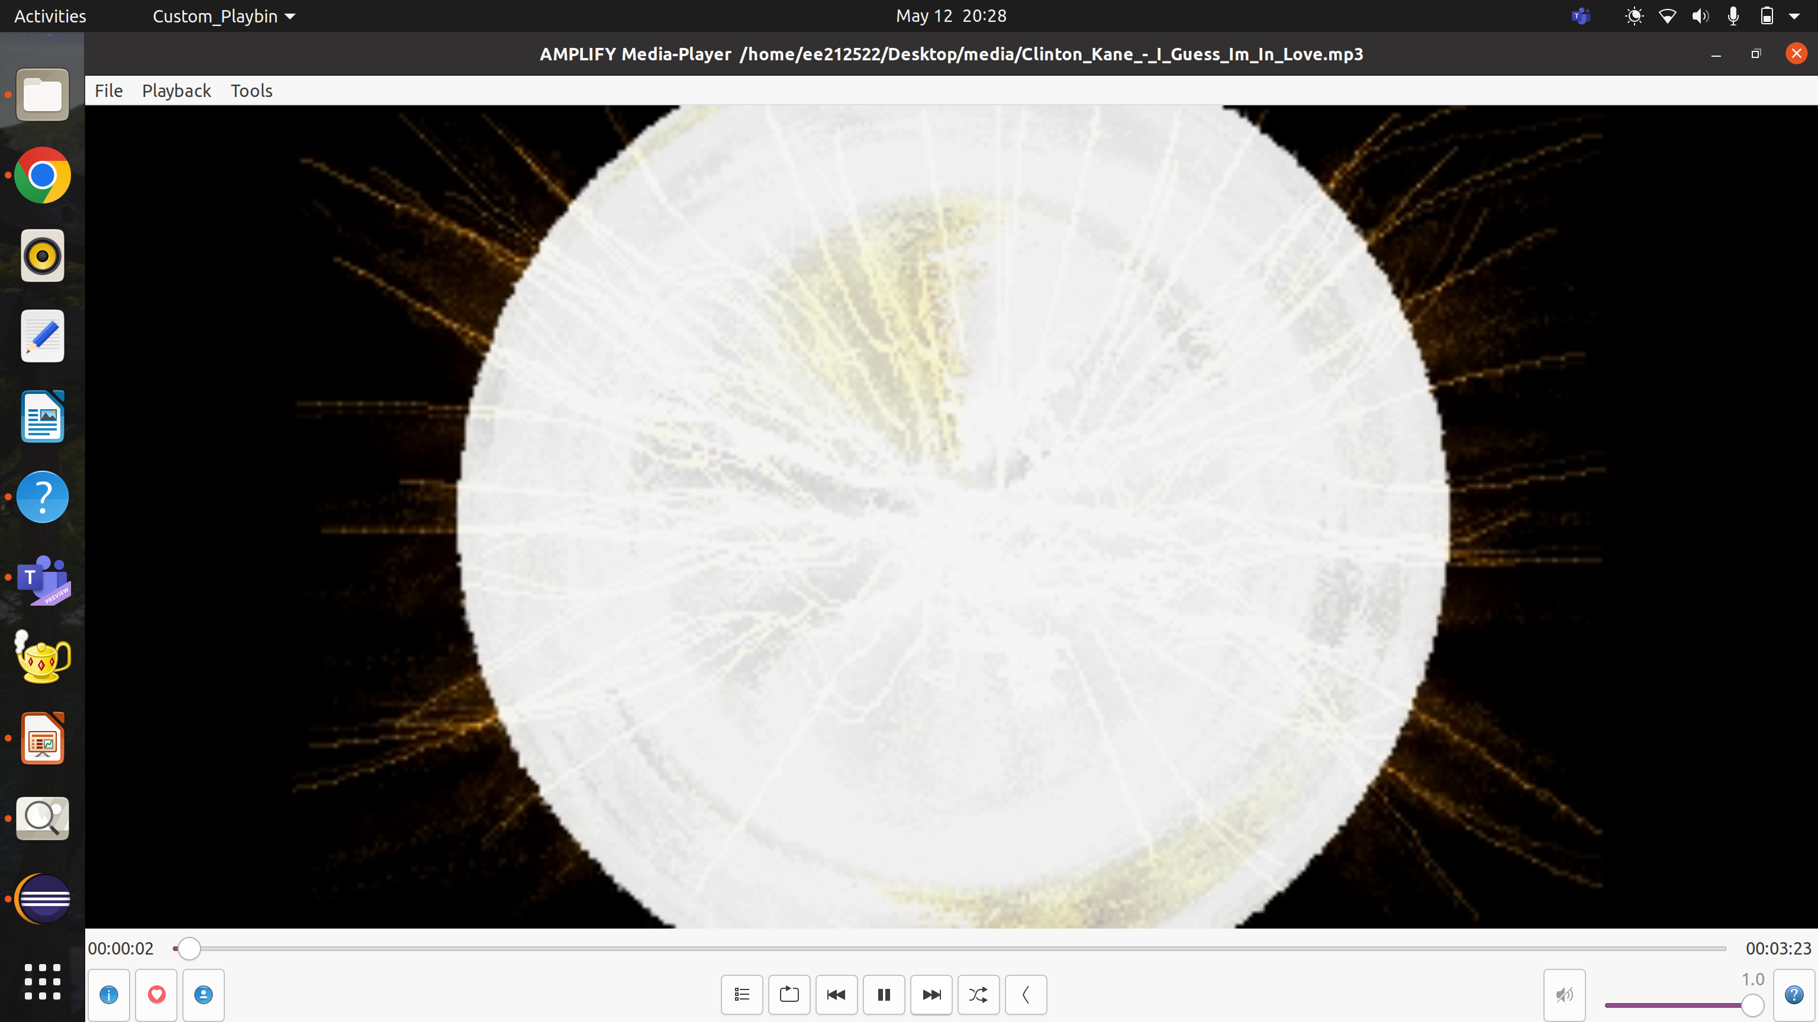
Audio Visualizer for Audio:

Slide 10
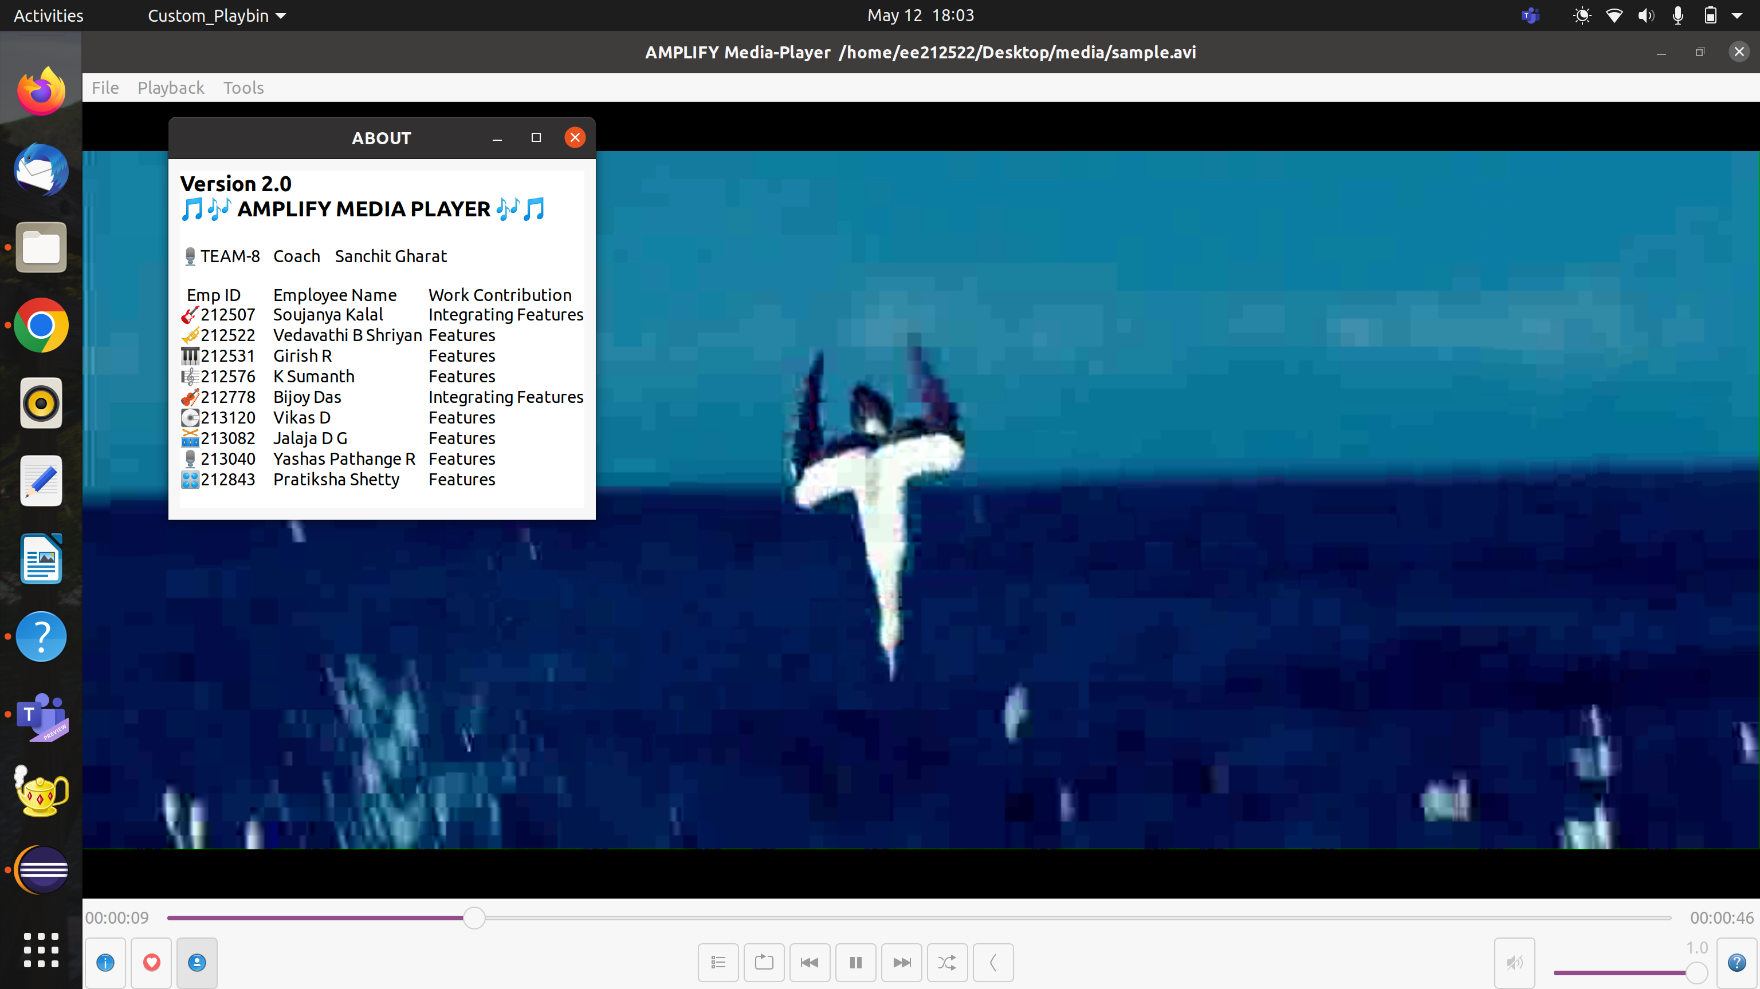
Version 2.0:

Slide 11
THANK YOU
Visit us at www.sasken.com
Queries: marketing@sasken.com

